Slide 1
Architecture

Slide 2
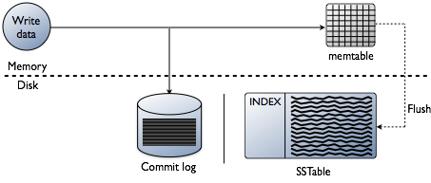
Write Cycle

Slide 3
Write Cycle
Logging data in the commit log
Writing data to the memtable
Flushing data from the memtable
Storing data on disk in SSTables

Slide 4
Commit Log
On disk
Optimised for writing
Used for Durability

Slide 5
Memtables
In memory
Used for optimisation
Configurable limit

Slide 6
SSTables
File of key value pairs, sorted by keys
Immutable
Stores data in Blocks

Slide 7
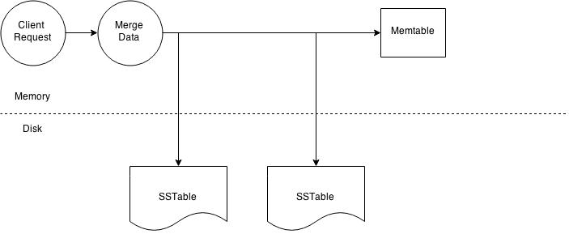
Read Cycle

Slide 8
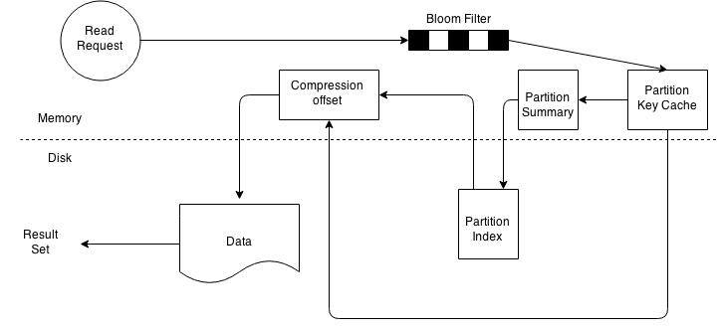
Read Cycle(SSTables)

Slide 9
Read Cycle
Check the memtable
Check row cache, if enabled
Checks Bloom filter
Checks partition key cache, if enabled
Goes directly to the compression offset map if a partition key is found in the partition key cache, or checks the partition summary if not
If the partition summary is checked, then the partition index is accessed
Locates the data on disk using the compression offset map
Fetches the data from the SSTable on disk

Slide 10
Bloom Filter
Probabilistic Data Structure
In off-heap memory
Each SSTable has a bloom filter associated with it
It can establish that a SSTable does not contain data
It can also find the likelihood that partition data is stored in a SSTable

Slide 11
Partition key Cache
stores a cache of the partition index
in off-heap memory
If a partition key is found in the key cache can go directly to the compression offset map to find the compressed block on disk that has the data
Configurable

Slide 12
Partition Summary
off-heap in-memory structure
stores a sampling of the partition index
sample frequency is changed using the index interval property in the table definition
Defaults to

Slide 13
Compaction
merging multiple SSTables into a single new one
todo

Slide 14
Compression offset map
stores pointers to the exact location on disk
stored in off-heap memory
accessed by either the partition key cache or the partition index
Compression is enabled by default
Having compression enabled makes the page cache more effective

Slide 15
Configurations
commitlog_total_space_in_mb
memtable_heap_space_in_mb
memtable_cleanup_threshold
index_summary_capacity_in_mb

Slide 16
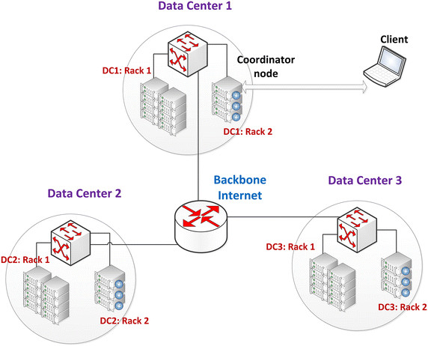
Data centers, Racks and Keyspaces

Slide 17
Keyspace
namespace that defines data replication on nodes
A cluster contains one keyspace per node
CREATE KEYSPACE [IF NOT EXISTS] keyspace_name
WITH REPLICATION = {
'class' : 'SimpleStrategy', 'replication_factor' : N }
| 'class' : 'NetworkTopologyStrategy',
'dc1_name' : N [, ...]
}
[AND DURABLE_WRITES = true|false] ;

Slide 18
SimpleStrategy
Assign the same replication factor to the entire cluster
Generally used for Single Data Center
places the first replica on a node determined by the partitioner
Additional replicas are placed on the next nodes clockwise in the ring without considering topology (rack or datacenter location)

Slide 19
NetworkTopologyStrategy
Used for cluster deployed across multiple datacenters
Specifies how many replicas you want in each data center
places replicas in the same data center by walking the ring clockwise until reaching the first node in another rack
attempts to place replicas on distinct racks

Slide 20
Snitches
A snitch determines which datacenters and racks nodes belong to
They inform Cassandra about the network topology so that requests are routed efficiently and allows Cassandra to distribute replicas by grouping machines into datacenters and racks
replication strategy places the replicas based on the information provided by the new snitch

Slide 21
Snitches
SimpleSnitch - The SimpleSnitch is used only for single-datacenter deployments.
RackInferringSnitch - Determines the location of nodes by rack and datacenter corresponding to the IP addresses(assumed to be 3rd and 2nd octet of each node’s IP).
PropertyFileSnitch - Determines the location of nodes by rack and datacenter explicitely configured in cassandra-topology.properties.
GossipingPropertyFileSnitch - Automatically updates all nodes using gossip when adding new nodes and is recommended for production.
Ec2Snitch – For Amazon EC2 in a single region. Only private IPs are used. Loads region and availability zone information from EC2 API.
Ec2MultiRegionSnitch - Amazon EC2 deployments where the cluster spans multiple regions. Uses public IPs as broadcast_address to allow cross region connectivity.
GoogleCloudSnitch - Use the GoogleCloudSnitch for Cassandra deployments on Google Cloud Platform across one or more regions.
CloudstackSnitch - Use the CloudstackSnitch for Apache Cloudstack environments.

Slide 22
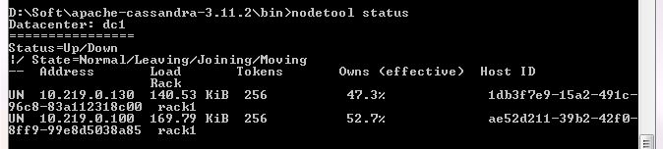
Datacenter and nodes

Slide 23
CQL
Data Definition statements, to define and change how the data is stored (keyspaces and tables).
Data Manipulation statements, for selecting, inserting and deleting data.
Secondary Indexes statements.
Materialized Views statements.
Database Roles statements.
Permissions statements.
User-Defined Functions statements.
User-Defined Types statements.
Triggers statements.

Slide 24
CQL literals and data types
blob - hexadecimal defined as 0[xX](hex)+ ex: 0x0000000000000003
boolean
Decimal – integer, floats
Identifier - Names of tables, columns, types, and other objects are identifiers
Integer, bigint, counter, smallint, tinyint, varint
frozen
String literal, text, varchar
Uuid – 32 hex digits
Date, time, timestamp
List, map, set, tuple(group of 2-3 fields)
Timeuuid - Uses the time in 100 nanosecond intervals since 00:00:00.00 UTC (60 bits), a clock sequence number for prevention of duplicates (14 bits), plus the IEEE 801 MAC address (48 bits) to generate a unique identifier. Ex: d2177dd0-eaa2-11de-a572-001b779c76e3
Whitespace – inside string literals, otherwise ignore
Supports exponential notation - -2.6034345E+38
Comment - //, --, /**/
User defined type

Slide 25
CQL limits
Cells in a partition: ~2 billion (2³¹); single column value size: 2 GB ( 1 MB is recommended)
Clustering column value, length of: 65535 (2¹⁶-1)
Key length: 65535 (2¹⁶-1)
Table / CF name length: 48 characters
Keyspace name length: 48 characters
Query parameters in a query: 65535 (2¹⁶-1)
Statements in a batch: 65535 (2¹⁶-1)
Fields in a tuple: 32768 (2¹⁵) (just a few fields, such as 2-10, are recommended)
Collection (List): collection limit: ~2 billion (2³¹); values size: 65535 (2¹⁶-1)
Collection (Set): collection limit: ~2 billion (2³¹); values size: 65535 (2¹⁶-1)
Collection (Map): collection limit: ~2 billion (2³¹); number of keys: 65535 (2¹⁶-1); values size: 65535 (2¹⁶-1)
Blob size: 2 GB ( less than 1 MB is recommended)

Slide 26
CQL shell commands
bin/cqlsh [options] [host [port]] – connecting to an IP
./cqlsh CQLSHRC="~/directory_name“ - Configuring cqlsh from a file
CAPTURE CAPTURE ['file_name' | OFF] - Appends the query results to a file in exponential notation format. Results do not appear in standard output; however error messages and cqlsh commands output displays in STDOUT.
CLEAR
CONSISTENCY [level]
COPY table_name [( column_list )]
FROM 'file_name'[, 'file2_name', ...] | STDIN
[WITH option = 'value' [AND ...]]- CQL shell commands that import and export CSV (comma-separated values or delimited text files)
DESCRIBE [FULL] SCHEMA | CLUSTER
| KEYSPACES | KEYSPACE keyspace_name
| TABLES | TABLE [keyspace_name.]table_name
| TYPES | TYPE [keyspace_name.]udt_name
| FUNCTIONS | FUNCTION [keyspace_name.]udf_name
| AGGREGATES | AGGREGATE [keyspace_name.]uda_name
| INDEX [keyspace_name.]index_name
| MATERIALIZED VIEW [keyspace_name.]view_name

Slide 27
nodetool – a few important commands
removenode : Provides the status of current node removal, forces completion of pending removal, or removes the identified node
assassinate : Forcefully removes a dead node without re-replicating any data. It is a last resort tool
bootstrap : Manage a node’s bootstrap process
drain : Flushes all memtables from the node to SSTables on disk
flush : for specific memtable to SSTables on disk
gossipinfo : gossip information for the cluster.
info : node info, uptime, load, cache.
gcstats : garbage collection statistics that returns values based on all the garbage collection that has run since the last time nodetool gcstats was run
join : Causes the node to join the ring, assuming the node was initially not started in the ring using the -Djoin_ring=false cassandra utility option
netstats : Provides network information about the host.
refresh : Loads newly placed SSTables onto the system without a restart.
status : information about the cluster, such as the state, load, and IDs.
tablestats : statistics about one or more tables.

Slide 28
Achilles(A Java API)

Slide 29
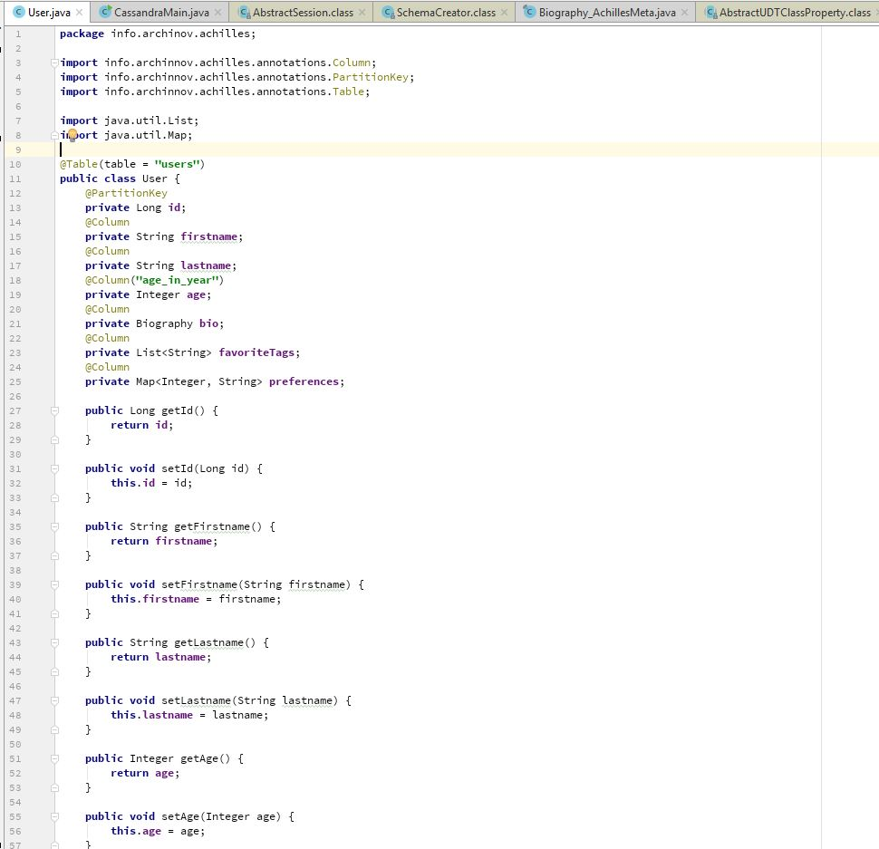
BeanMapping

Slide 30
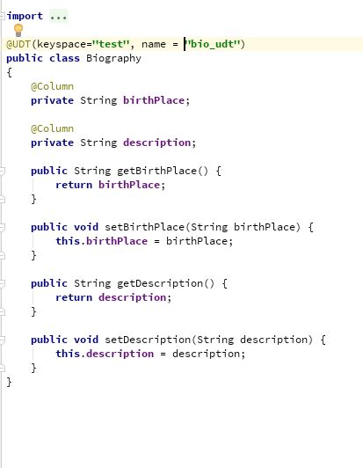
User Defined Type

Slide 31
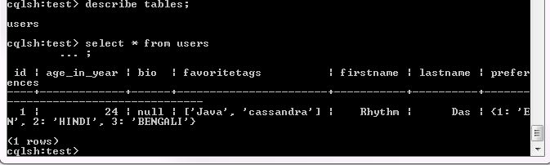
Data

Slide 32
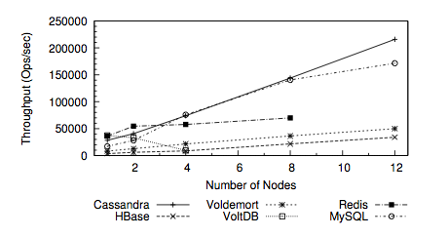
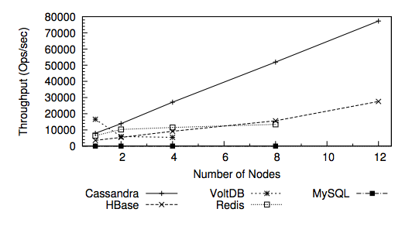
Performance
Throughput for workload Read/Write
Throughput for workload Read/Scan/Write

Slide 33
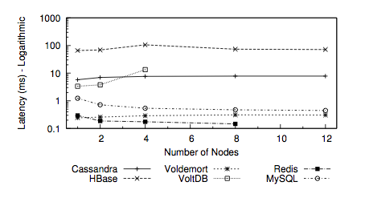
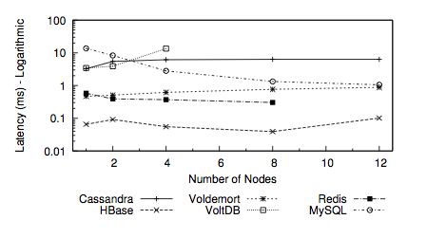
Performance
Read latency for workload Read/Write
Write latency for workload Read/Write

